Slide 1

This week we practised reading words that contain adjacent consonants anywhere in the word.

Slide 2

This week we continued to learn to read adjacent consonants and met the new tricky words were, there, little and one.

Slide 3
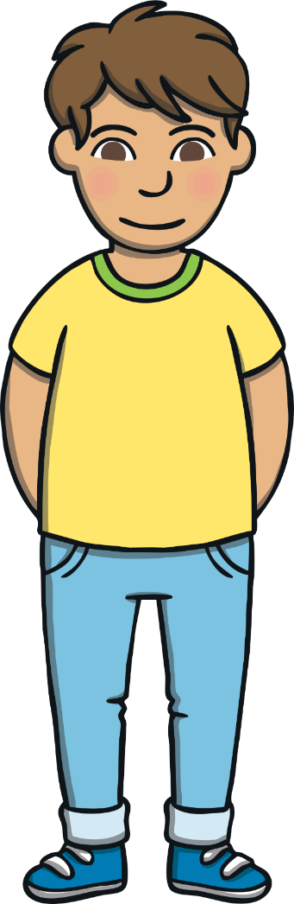
This week, we met our next tricky words – were, there, little, one.
Tricky words are words that can’t be sounded out. We just have to learn them off by heart!

Slide 4
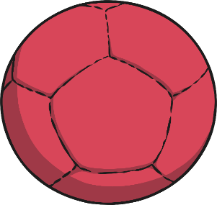


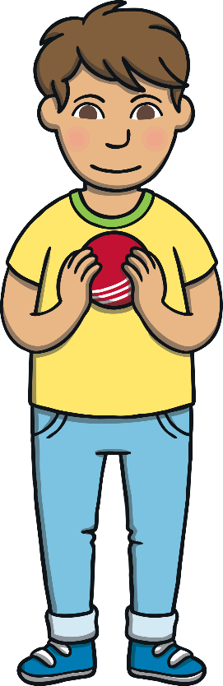


were
little
one
there

Slide 5
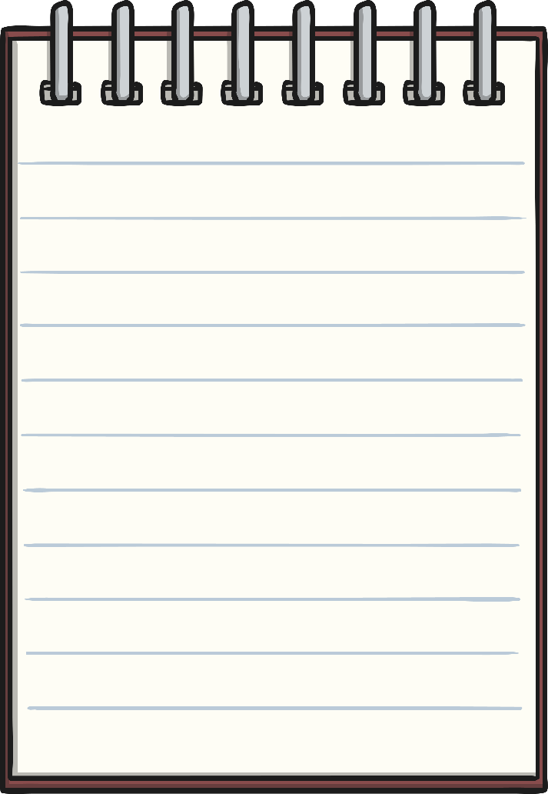
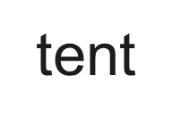
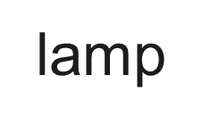
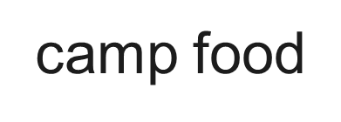
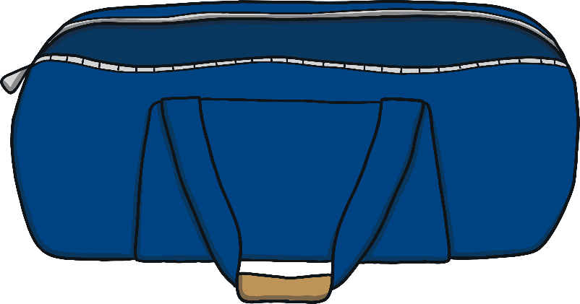
Adjacent Consonants
spoon
brush

