Slide 1

Sound of the week
ay

Slide 2




ay
Use your wand
Trace the letters on the screen
Write the sound in the sky
Write it on your forehead
Write it on the floor

Slide 3

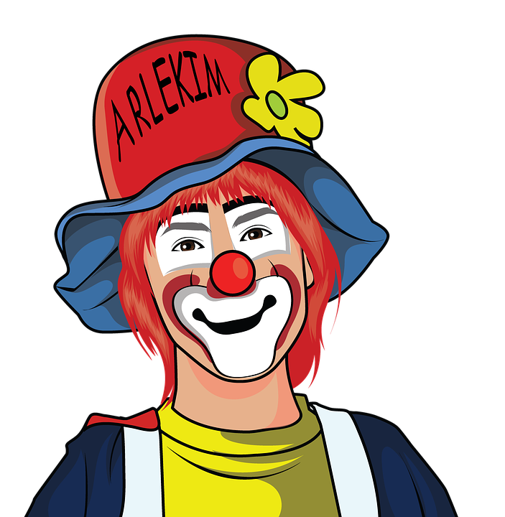
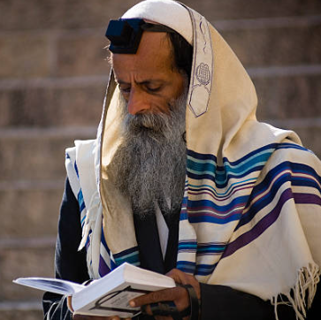
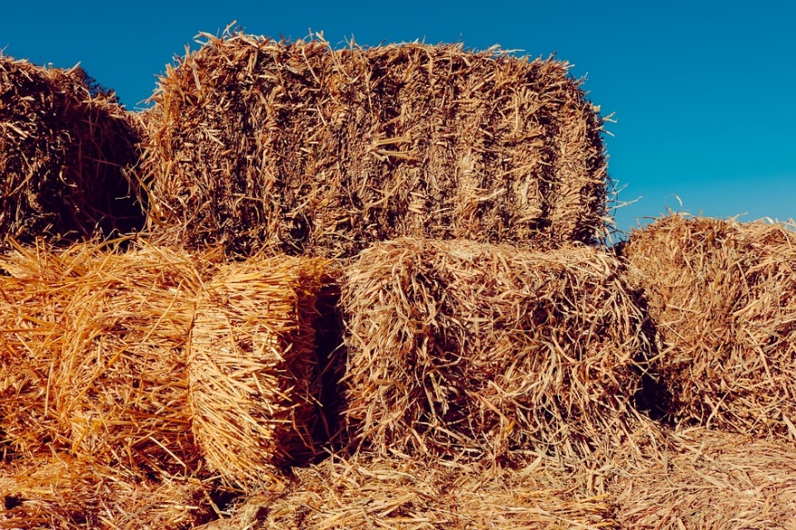

Find the odd one out

Slide 4
Sound it out!
day

Slide 5
hay

Slide 6
pray

Slide 7
sway

Slide 8
delay

Slide 9
doorway

Slide 10
Phoneme count
may

Slide 11
m
ay
2

Slide 12
Tuesday

Slide 13
ue
s
d
ay
T
5

Slide 14
holiday

Slide 15
h
o
l
d
i
ay
6

Slide 16
Phoneme Spotter - ay
I fed the hay to the horse.
On Wednesday Brian goes swimming.
The train we took today was delayed.

