Slide 1

Phonic sounds taught this week
ck e u r

Slide 2

We had another fun week of learning phonics. The boys are excited to have learnt so many sounds. We continue to blend with Robot Rick every day.

Slide 3

At the end (or near the end) of some words, the c or k sound is written with both letters:
ck

Slide 4


Slide 5


Action
Make an egg with one hand and tap it with the other.
Say ‘e, e, e’.

Slide 6


Slide 7

Action
Make an umbrella with one hand and sprinkle rain on it with the other.
Say ‘u, u, u’.

Slide 8


Slide 9
Action
Move your arms like a robot.
Say ‘r, r, r’.

Slide 10
This week, we met our first tricky words – to and the. Tricky words are words that can’t be sounded out. We just have to learn them off by heart!

Slide 11


the

Slide 12

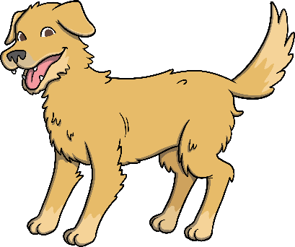


Challenge Time! Can you robot talk these pictures?

