Slide 1

Phonic sounds taught this week
ff ll ss s saying /z/

Slide 2
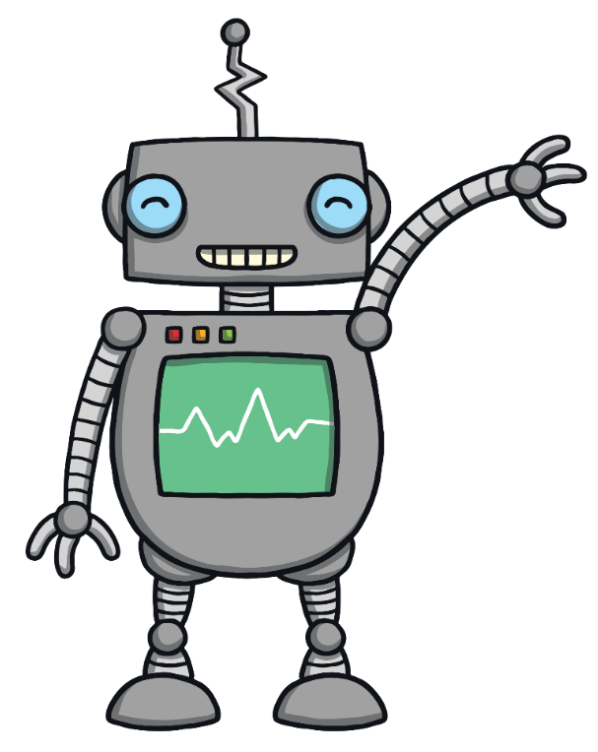
We have reached the end of learning all the level 2 sounds and are excited to begin level 3! We will continue revising all the sounds learnt so far.

Slide 3


At the end of some words, the f sound is written as:

Slide 4

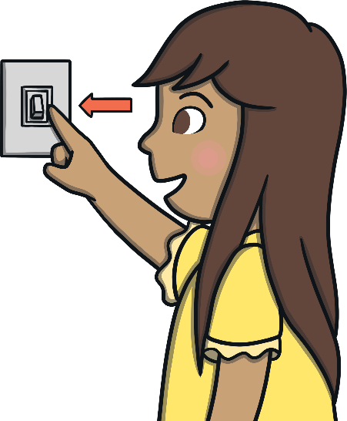
Action
Turn the light switch off.
Say ‘ff, ff, ff’.

Slide 5


Slide 6
Action
Ring the bell.
Say ‘ll, ll, ll’.

Slide 7


Slide 8
At the end of some words, the letter s makes the /z/ sound.
is
It can also be found at the end of some other words, such as his, has, is, as.

Slide 9
See if you can read these captions. Don’t let the tricky words trick you!
The bell fell in the bin.
Sam and Ben go huff and puff.

Slide 10
Can you read these tricky words? I no go to the

