Slide 1


Revisit and Review
Let’s practise Sam’s Sounds and Common Exception Words!
house
many
work
laughed

Slide 2
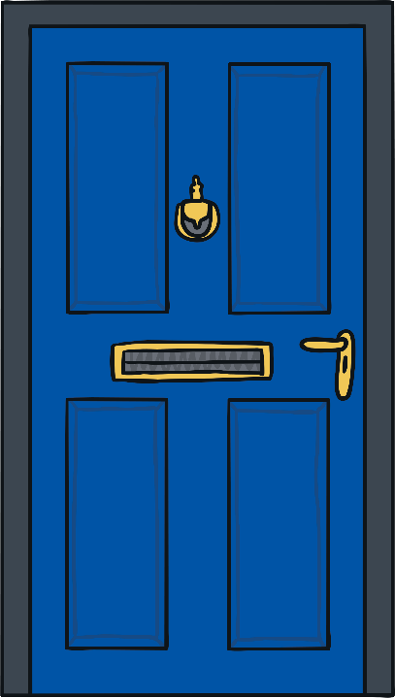
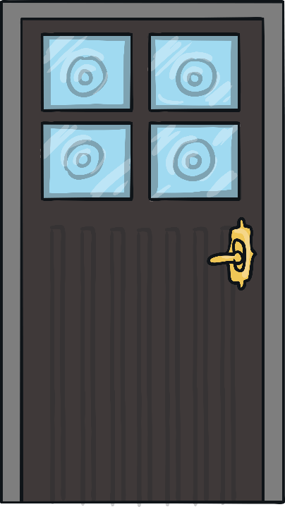



Teach
girl
bird
first
dirt

Slide 3

Clothes Sort
Practise
Read the words on the clothes and decide if they are real or nonsense words.
The real words go in Kit and Sam’s drawers and the nonsense words in the charity bag. Click the words to find out if you were correct.

Slide 4

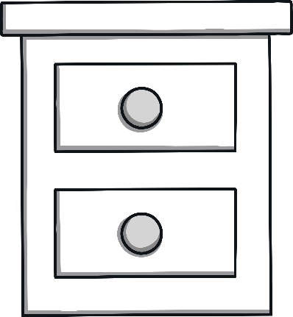
Practise
mirst
Sir
thirk
girl
bird
skirp
thirst
blirf

