Slide 1

Phonic sounds taught this week
j v w x

Slide 2

This week we began learning level 3 sounds as well as revising the level 2 ones. We continue to work on blending and segmenting with Robot Rick.

Slide 3



Slide 4

Action
Sweep your hand up like a jumbo jet taking off.
Say ‘j, j, j’.

Slide 5


Slide 6


Action
Draw a v shape on your chest to show the V-neck of the vest.
Say ‘v, v, v’.

Slide 7


Slide 8
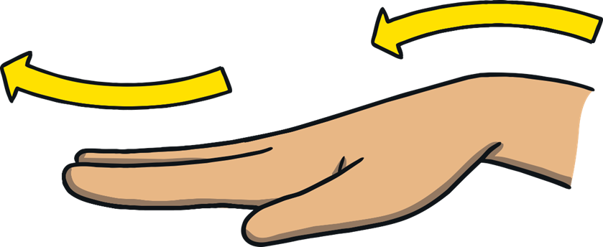
Action
Make waves with your hand.
Say ‘w, w, w’.

Slide 9


Slide 10
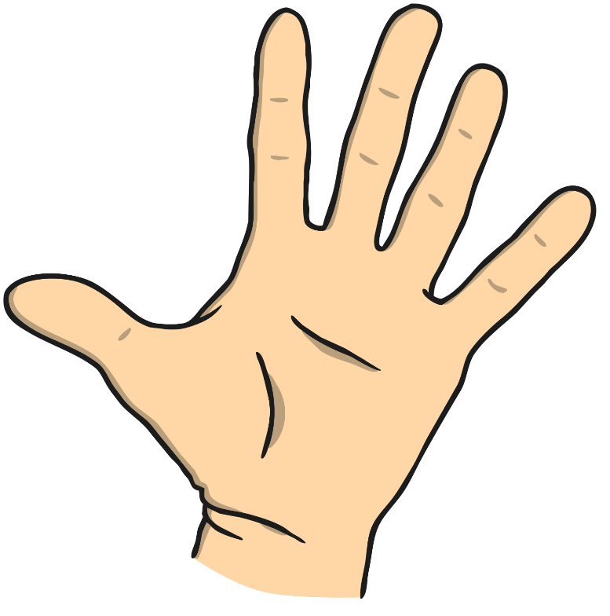
Action
Hold one hand like a map and draw x on it.
Say ‘x, x, x’.

Slide 11

Jack
jam
jog

Slide 12



