Slide 1

Phonic sounds taught this week
igh oa

Slide 2

This week we learnt 1 new digraph and a trigraph! Can you remember what a trigraph is? We also met the new tricky word my.

Slide 3
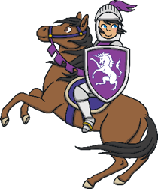

Slide 4

Action
Hold your shield with one arm and pat it with the other.
Say ‘igh, igh, igh’.

Slide 5
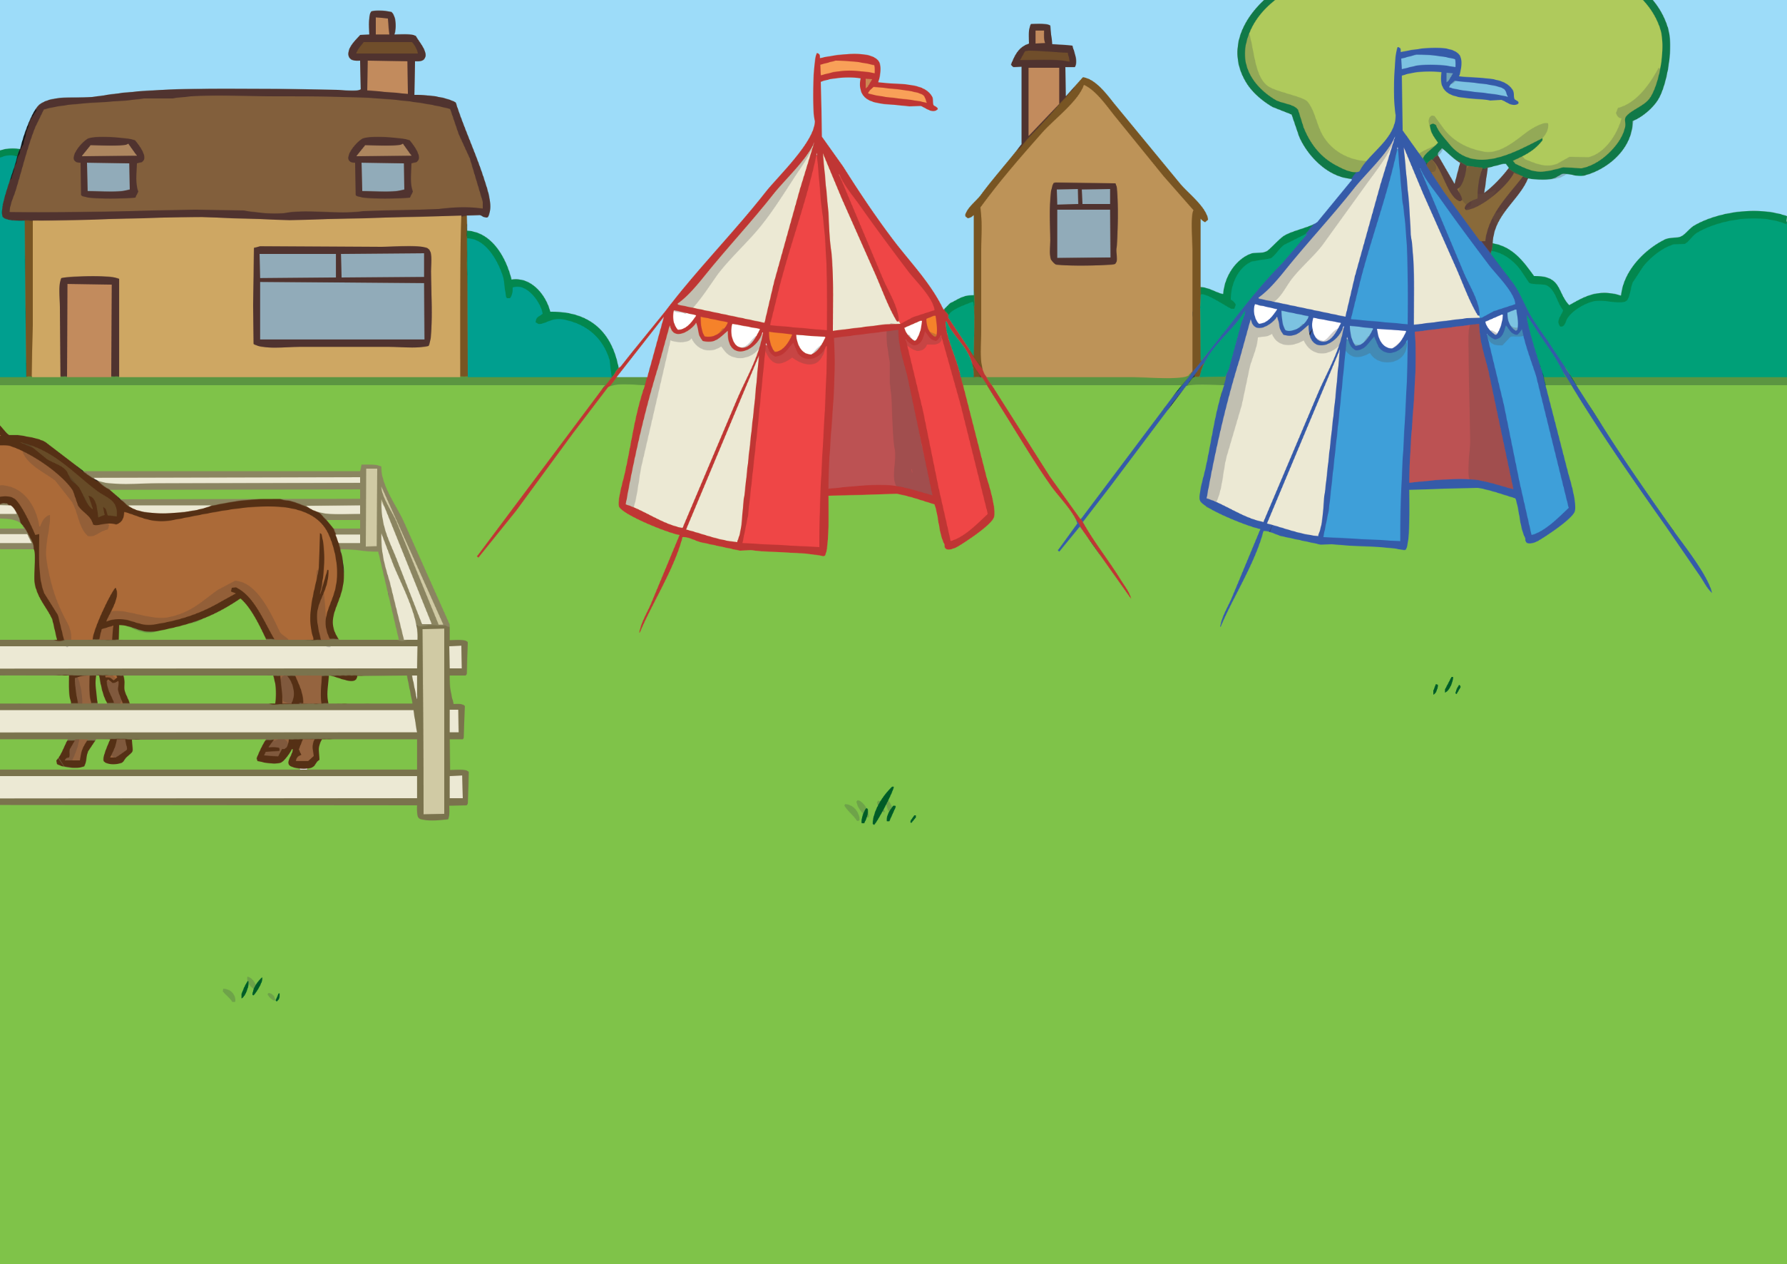






Slide 6
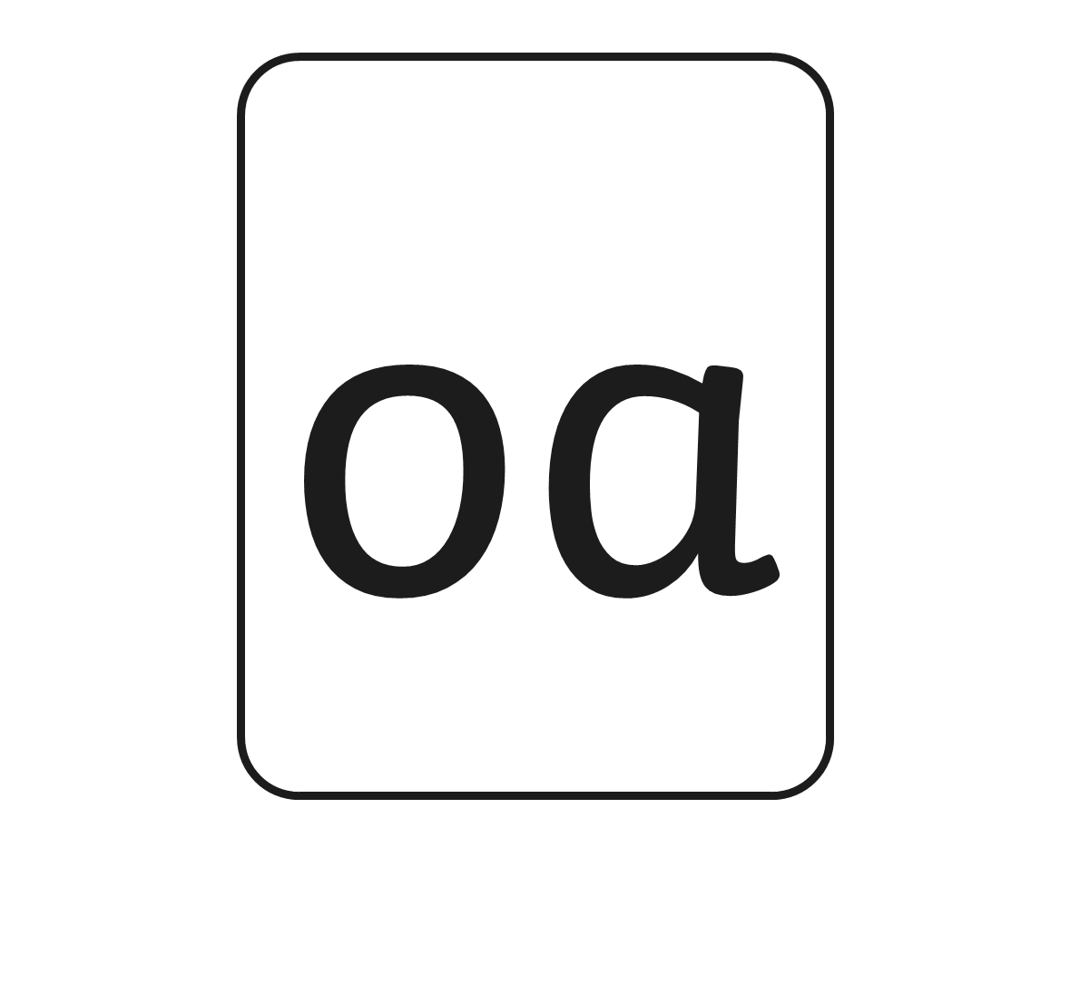

Slide 7
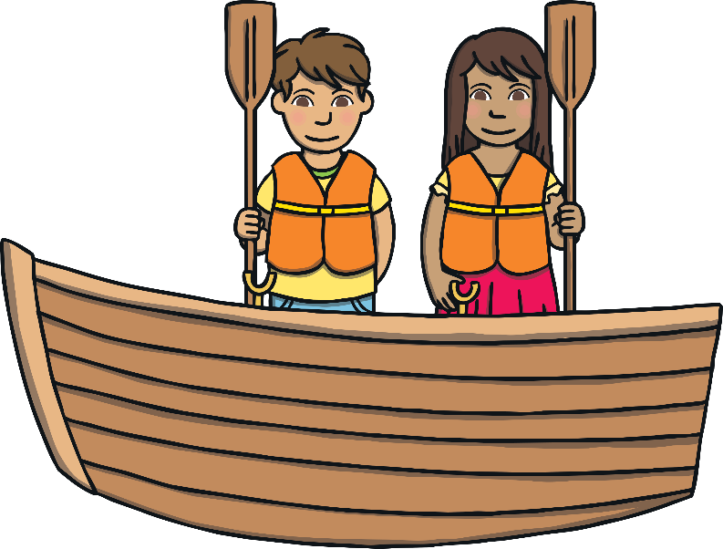
Action
Pretend to row your boat.
Say ‘oa, oa, oa’.

Slide 8
Challenge! Listen to the oa words and then segment them.

