Slide 1

Sound of the day
o_e

Slide 2



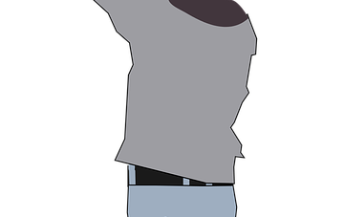
o_e
Use your blue paint.
Trace the letters on the screen.
Write the sound in the sky.
Write it on your shoe.
Write it on your back.

Slide 3

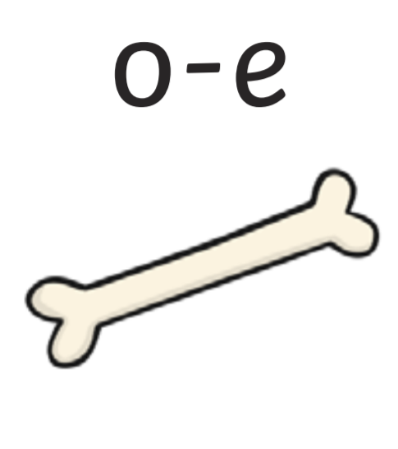

Slide 4
bone

Slide 5
b
n
o e

Slide 6
home

Slide 7
h
o e
m

Slide 8
cone

Slide 9
c
o e
n

Slide 10
phone

Slide 11
n
ph
o e

Slide 12

globe

Slide 13
g
l
o e
b

Slide 14
explode

Slide 15
e
x
p
l
o e
d

Slide 16
envelope

Slide 17
e
p
n
v
e
l
o e

Slide 18
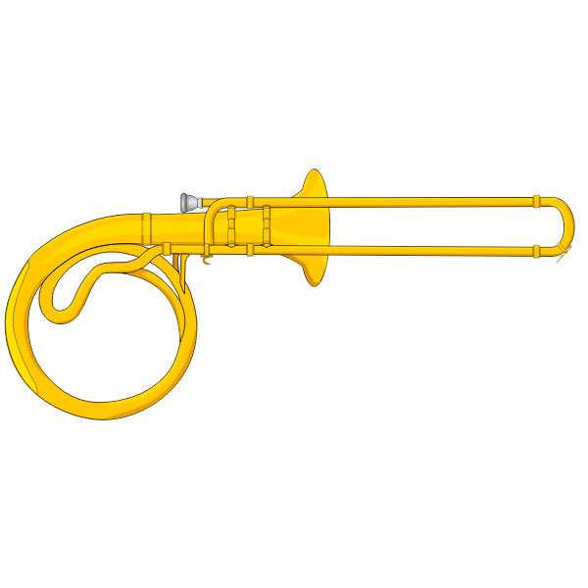
trombone

Slide 19
t
m
b
n
o
o e
r

Slide 20
Phoneme Spotter o-e
Can a stone explode?
If you and your mother are home alone and you find a bone will you get on the phone?

Slide 21
Where in the word?
globe token
explode bone

Slide 22
Sound of the day
i_e

Slide 23
like

Slide 24
slime

Slide 25
shine

Slide 26
brine

Slide 27
slide

Slide 28
prize

Slide 29
bike

