Slide 1

Phonic sounds taught this week
or ur
Tricky word-they

Slide 2

This week we learnt 2 new digraphs and a new tricky word. Can you remember the new tricky word?

Slide 3

This week, we meet our next tricky word – they.
Tricky words are words that can’t be sounded out. We just have to learn them off by heart!

Slide 4


Slide 5


Action
Pretend to press a car horn.
Say ‘or, or, or’.

Slide 6

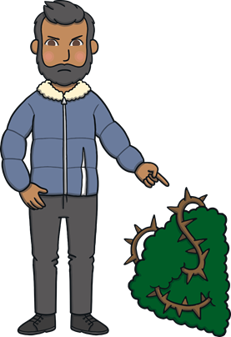
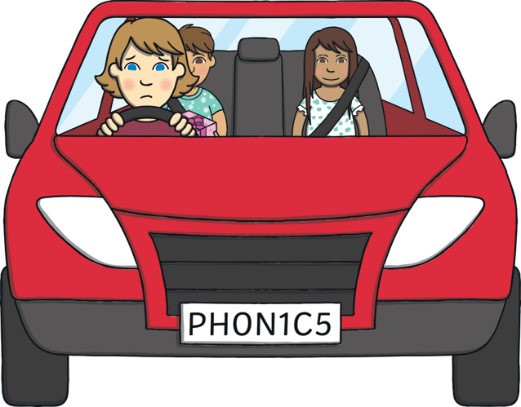



Slide 7


u and r are partners. They say ur.

Slide 8


Action
Pretend to open a purse.
Say ‘ur, ur, ur’.

Slide 9





