Slide 2

Phonics
wh
Phase 5

Slide 3

Let’s revise some of our phonemes.

Slide 4
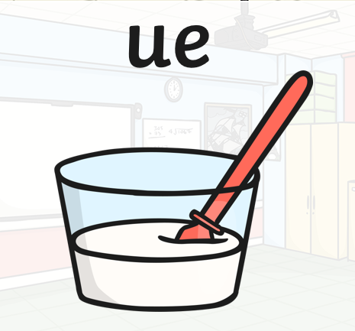

Slide 5


Slide 6
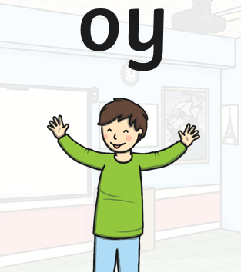

Slide 7


Slide 8
Sound of the week
wh

Slide 9
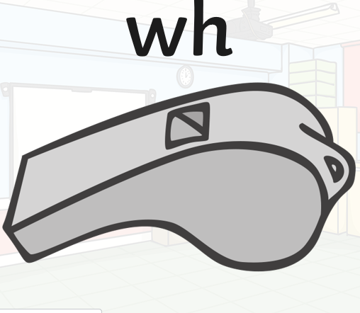

Slide 10



wh
Use your wand
Trace the letters on the screen
Write the sound in the sky
Write it on your forehead
Write it on the floor

Slide 11
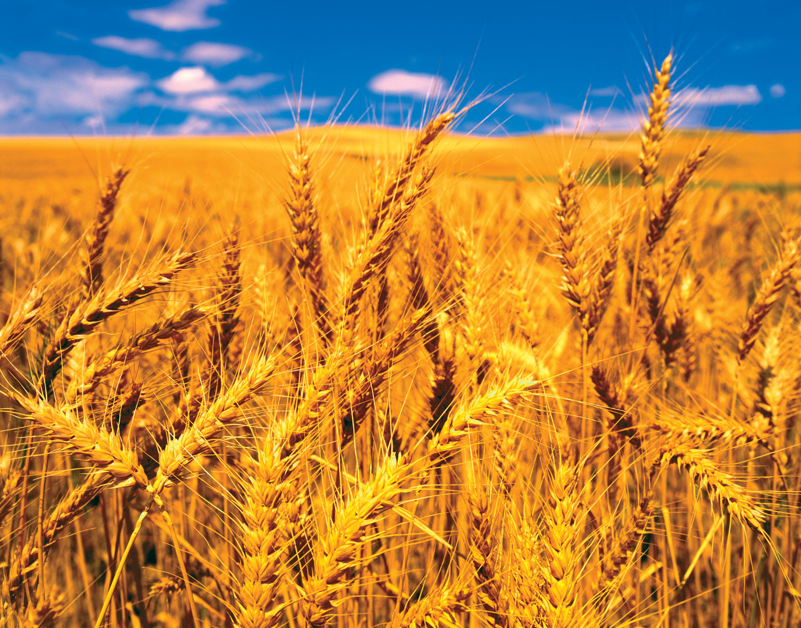
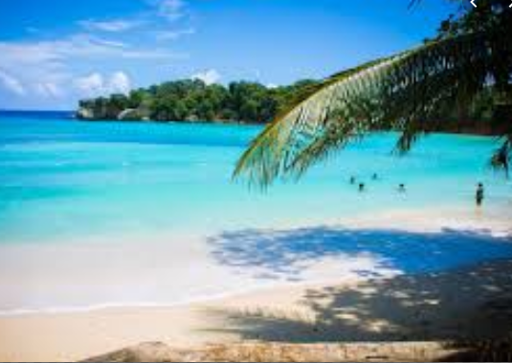
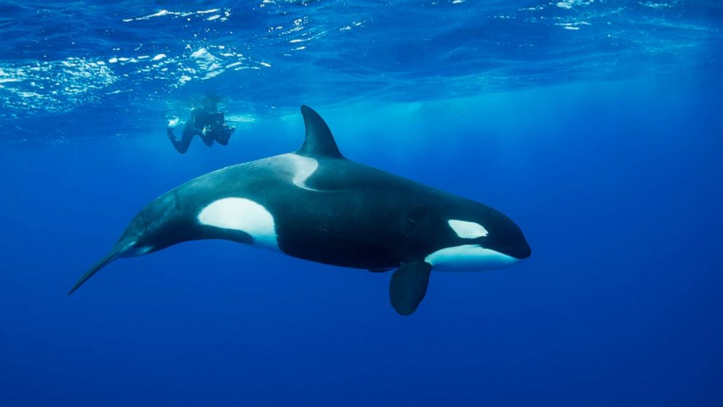
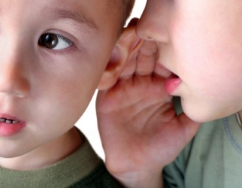
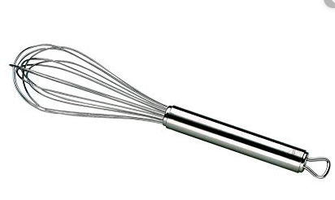
Find the odd one out

Slide 12
Sound it out!
whale

Slide 13
whisper

Slide 14
whisk

Slide 15
wheat

Slide 16
Phoneme Spotter - wh
You need wheat to make bread.
What is your name?
Whales are large sea creatures!

