Slide 1
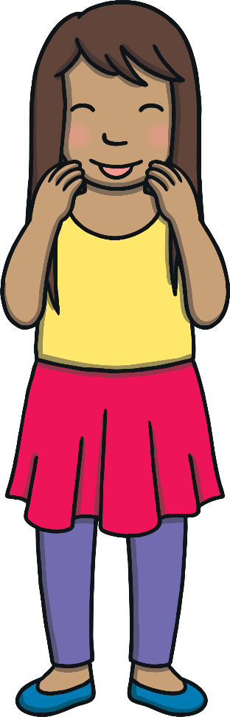



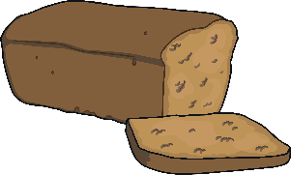
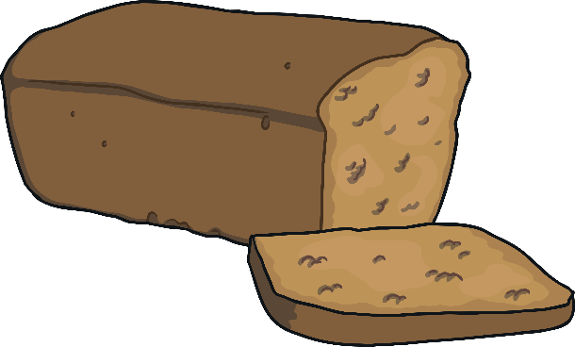

Revisit and Review
Let’s practise Sam’s Sounds and Common Exception Words!
ph
ie
wh
ea
ea
February
January
before
more

Slide 2
Teach
When you see e and a working as partners, they sometimes makes the /e/ sound. Let’s say these examples:
head
ready
instead

Slide 3

Teach
healthy
deaf
ready
bread
head

Slide 4





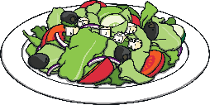

Practise
head
Score
Board
0
0
1

Slide 5
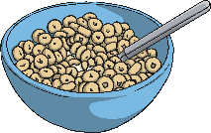

Practise
bread
Score
Board
0
2
0
1

Slide 6
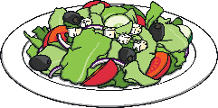



Practise
healthy
Score
Board
0
3
0
2

Slide 7

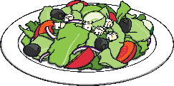
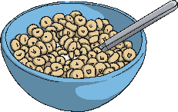
Practise
breakfast
Score
Board
0
3
4
0

Slide 8



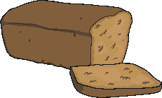
Practise
weather
Score
Board
0
4
5
0

