Slide 1

This week we learnt: to read words with adjacent consonants.

Slide 2

This week the boys were excited to begin level 4! We learnt how to read adjacent consonants and met the new tricky words said and so.

Slide 3
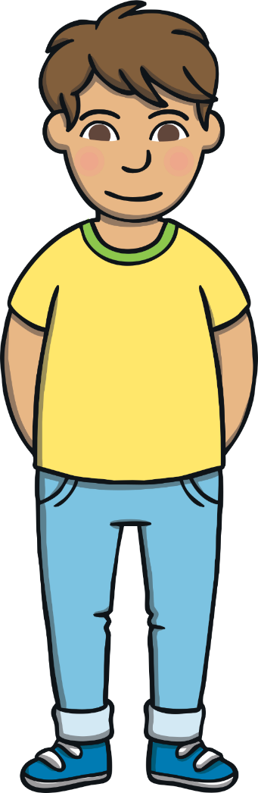
This week, we met our next tricky words – said, so.
Tricky words are words that can’t be sounded out. We just have to learn them off by heart!

Slide 4

my he me she be we was all you they
here are

Slide 5

Adjacent Consonants
When two or more consonants next to each other in a word make their own sound, we call them ‘adjacent consonants’. Adjacent consonants can appear at the beginning, middle or end of a word.
milk
clip

Slide 6

hunt
wind

