Slide 1

This week we learnt: to read words with adjacent consonants.

Slide 2

This week we continued to learn to read adjacent consonants and met the new tricky words have, like, some and come.

Slide 3
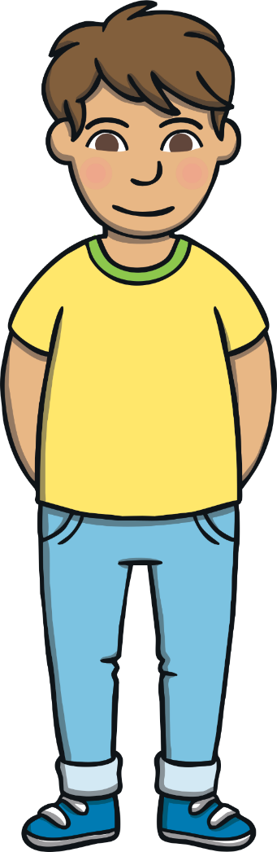
This week, we met our next tricky words – have, like, some, come.
Tricky words are words that can’t be sounded out. We just have to learn them off by heart!

Slide 4

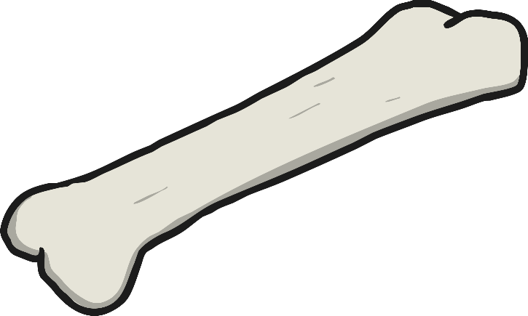
have
like
come
some

Slide 5
Adjacent Consonants
When two or more consonants next to each other in a word make their own sound, we call them ‘adjacent consonants’. Adjacent consonants can appear at the beginning, middle or end of a word. This week we focused on reading adjacent consonants at the beginning of a word.
tree flag grass frog

Slide 6
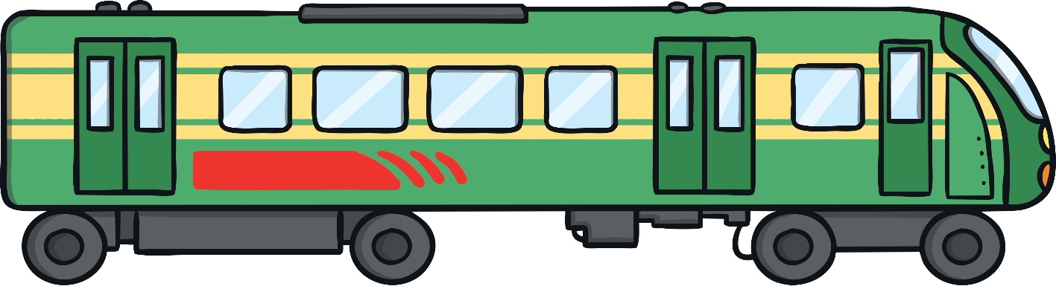
He is glad to see that the train has come to a stop.

